Slide 1

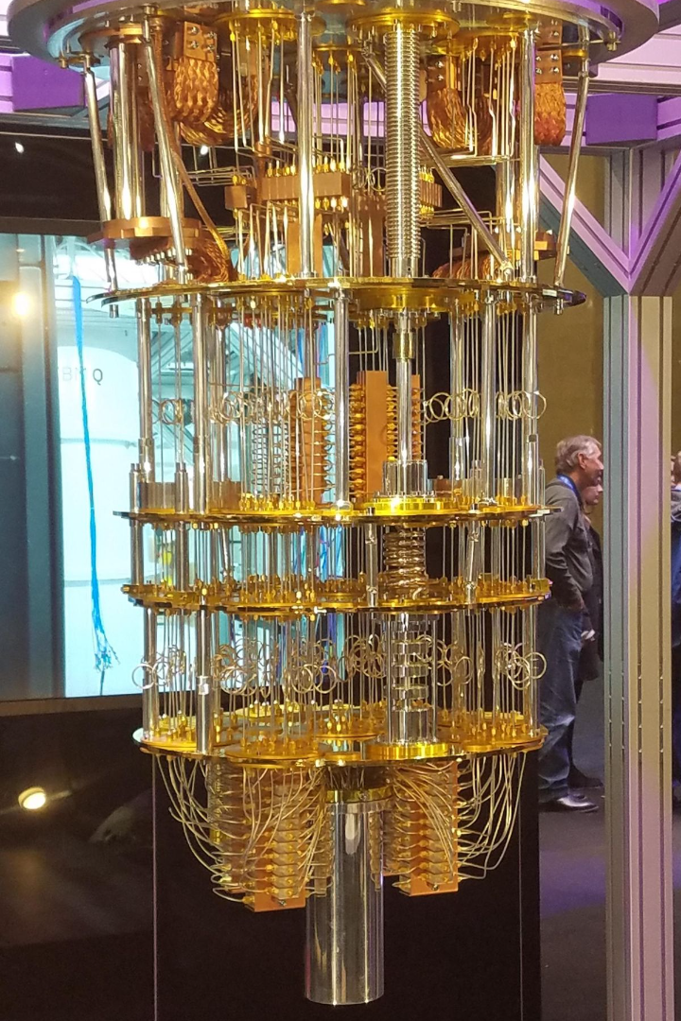
Unlocking the Quantum Future: Intro to Quantum Computing
"Hey, folks! Today, buckle up for a mind-bending journey. We're delving into the world of quantum computing, where 'impossible' takes on a whole new meaning. Get ready to unlock the secrets of the quantum future with me!"

Slide 2
What is Quantum Computing?
1
Quantum bits (qubits)
2
Quantum Gates
3
Quantum Algorithms
Quantum gates control the flow of information within a quantum computer, enabling complex calculations and algorithms.
Unlike classical bits which can only represent 0 or 1, qubits can exist in a superposition of states, allowing for incredible computational power.
Developing algorithms that leverage quantum properties can unlock solutions that are infeasible for classical computers.

Slide 3
Quantum Magic: Superposition and Entanglement
Superposition
Entanglement
Quantum Weirdness
Quantum systems can be simultaneously in multiple states, exponentially increasing processing capabilities.
When entangled, the states of qubits become interconnected, allowing information to be shared instantaneously.
Quantum mechanics defies our classical intuition and presents us with a new realm of possibilities.

Slide 4

Quantum Applications in Everyday Life
1
Supercharged Computing
Quantum computers can process problems much faster, potentially transforming industries by optimizing tasks we once thought were too complicated.
2
Unbreakable Security
Quantum computers can create codes that are practically unbreakable, securing our online transactions and data with a level of protection never seen before.
3
Drug Discovery
Quantum computers can process this data much faster, accelerating medical discoveries and potentially leading to more effective treatments and personalized medicine.
4
Superpowered Artificial Intelligence
Quantum computers can supercharge AI, allowing machines to learn and make decisions at speeds that were previously unimaginable, opening new possibilities for automation and problem-solving.

Slide 5
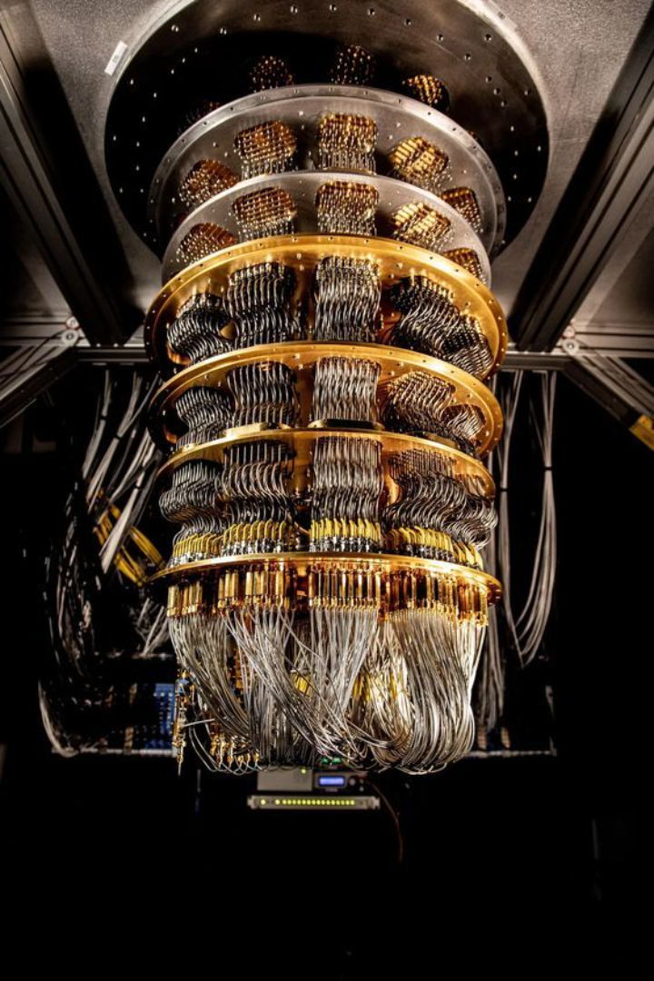
Threats of Quantum Computing and Prevention
If the encryption key length is 128 bits, then the number of possible keys is 2¹²⁸, which is an astronomically large number. To be precise, 2¹²⁸ is equal to 340,282,366,920,938,463,463,374,607,431,768,211,456. This immense key space is a fundamental aspect of strong encryption, making it computationally infeasible for traditional computers to brute-force or guess the correct key.
Quantum computers have the potential to crack conventional encryption, exposing private data. To prevent this, we must adopt quantum-resistant encryption methods that can withstand the computational power of quantum attacks.

Slide 6
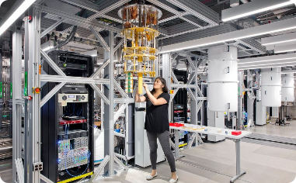
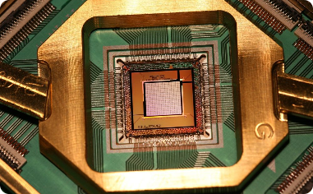

Real-Life Examples
IBM Q
Google's Sycamore
China's Quantum Satellite
The IBM Q Experience provides cloud access to real quantum processors and simulators, democratizing quantum exploration.
In 2019, Google achieved quantum supremacy, solving a complex problem in minutes that would take classical computers thousands of years.
China launched a quantum satellite to test secure communication by sending unbreakable codes from space to the ground.

Slide 7

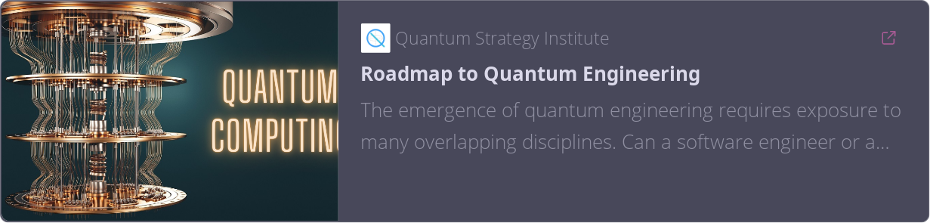
Encouragement
Join the Quantum Adventure:
Even if you're not a scientist, you can be part of this incredible journey. Quantum computing is an exciting field with endless possibilities. Who knows what amazing things we'll discover together!
Notes:
Reviewer’s Note (Siddhant Raut)
Should have increased the font-size.

